Slide 1
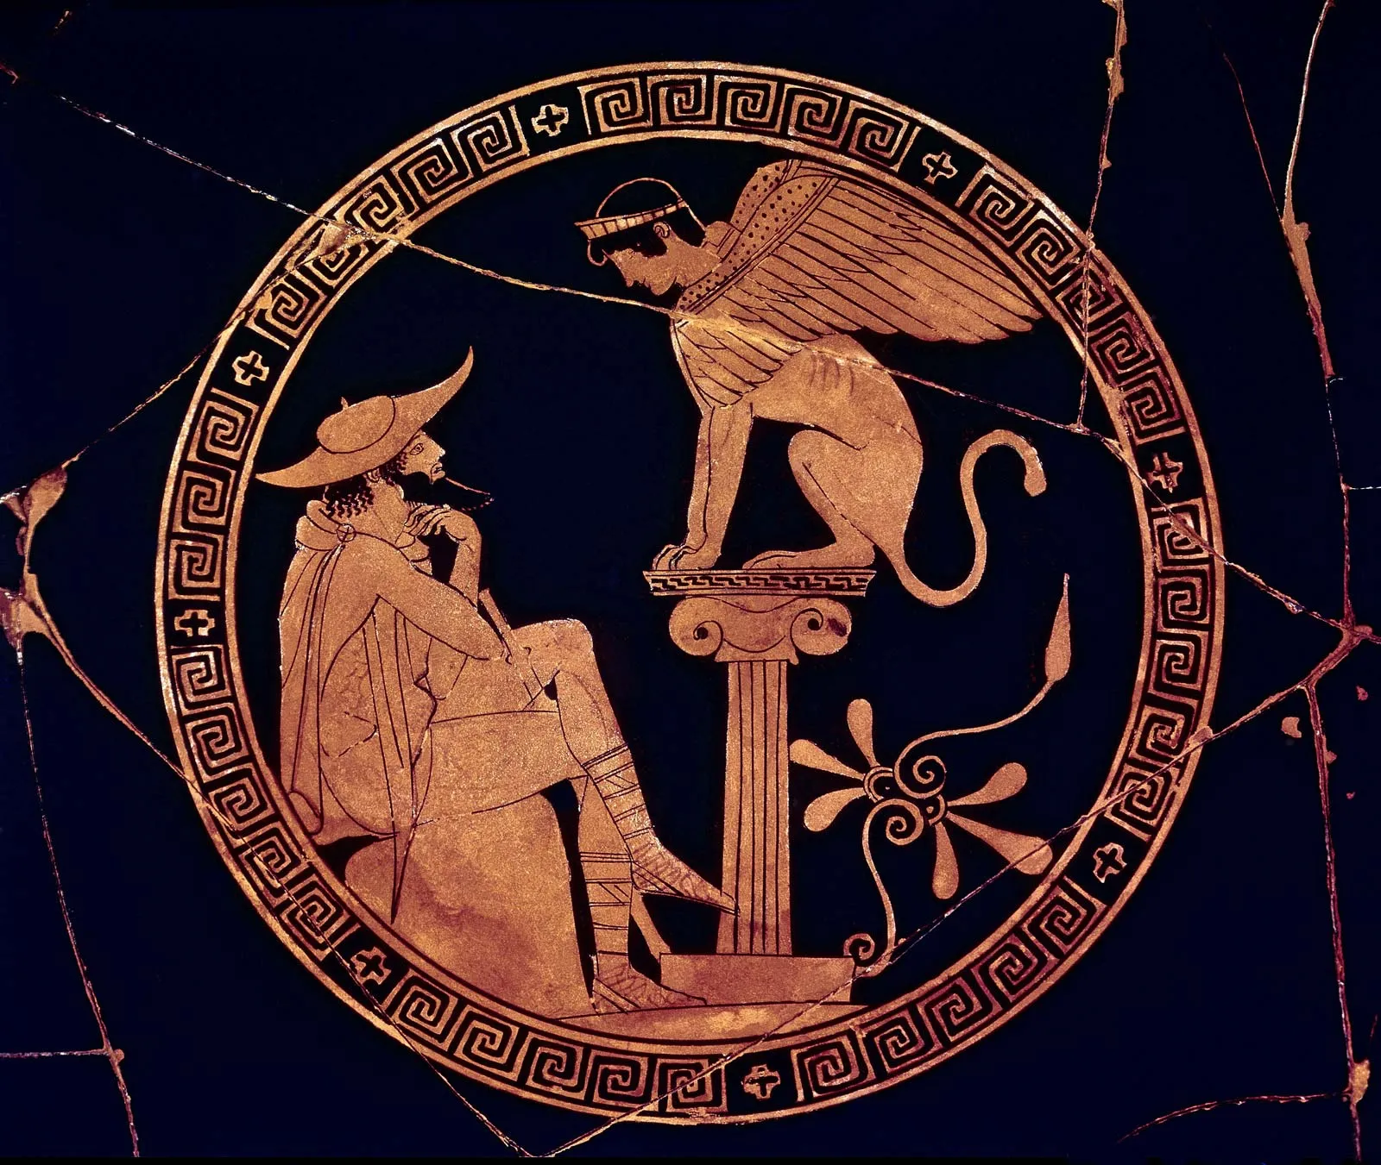
“We as a culture seem to be dedicated to the idea that ‘negative’ human emotions need to be fixed, managed, or changed—not experienced as part of a whole life” - Steven C. Hayes
Hardship and Acceptance
Historical/Philosophical look
Tracing lineage of thought
Transcends cultural boundaries and spans millennia
Engrained in zeitgeist, importance
Show parallels with modern psychology
Stoicism
Zeno of Citium (3rd century BC)
Marcus Aurelius (161-180 AD), Five Good Emperors
Physics, logic, and ethics. Virtue and Wisdom
Pneuma “breath”, gives quality and characteristics, Human souls
Humans a part of creation- accommodate to good and bad
“Amor Fati” – Love of Fate, embrace fate
“-to live as nature requires”
“The world is nothing but change. Our life is only perception”
“Disturbance comes only from within—from our own perceptions”
“Your soul takes on the color of your thoughts”
- Marcus Aurelius (Meditations)
Acceptance, Mindfulness, CBT, Perception, Locus of Control
Cognitive Distortions, Magical Thinking, Though Action Fusion, Black and White Thinking, Catastrophizing, Rigidity, Reassurance and Uncertainty
Acknowledge hardship is an aspect of life
Accipio
Ad (towards) capiō
(I take)
“For I am taught by suffering to endure” – Oedipus Antigone
Transitive
Agentic
Conscious Action
“Know Thyself” “Nothing overmuch” “A pledge, and thereupon perdition.”
-Delphic maxims

Slide 2
Extra
Daoism
Lao Tzu (6th – 5th century BC), legacy earlier
Dao/Tao (roughly “The Way”) architecture of the universe
Dao is flexible, present, various, context dependent
Live in accordance with Dao, guiding
Merges with Buddhism- Zen Buddhism
The course of nature of things is such that
What was in front is now behind;
What warmed anon we freezing find…
“The excellence of water appears in its benefiting all things, and in its occupying, without striving ( to the contrary)…”
“A violent wind does not last for a whole morning; a sudden rain does not last for a whole day…”
“If you keep feeling a point that has been sharpened, the point cannot preserve its sharpness”
-Lao Tzu (Tao Te Ching)
Meditation, Mindfulness, Body scanning
Rigidity, Rumination
Accipio
Ad (towards) + capiō
(I take)
Transitive
Agentic
Conscious Action

Slide 3
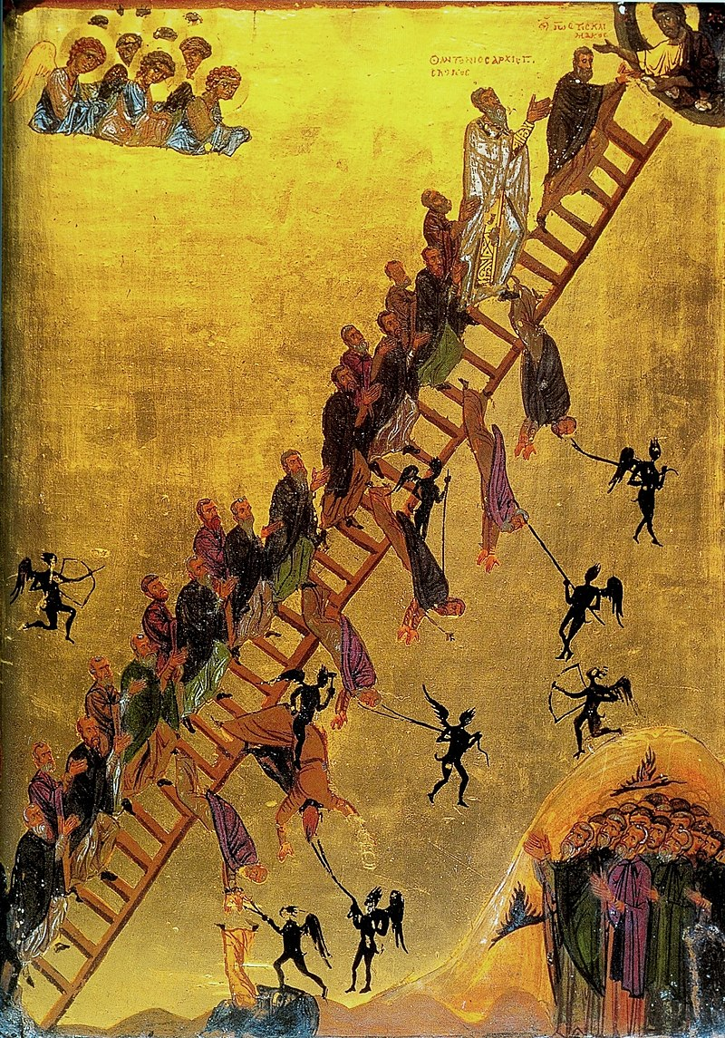
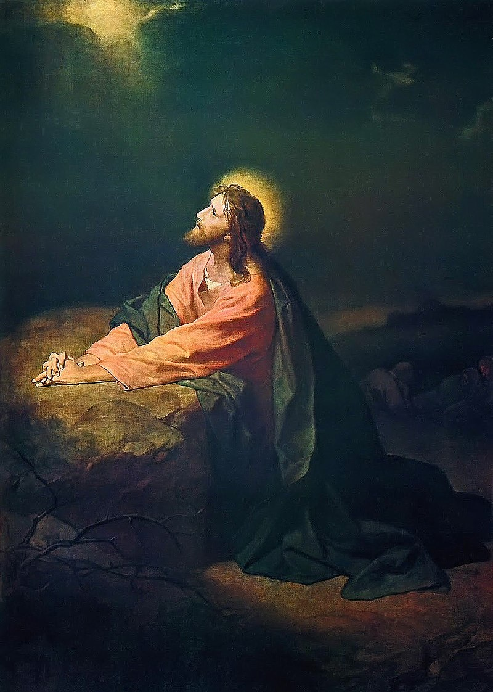
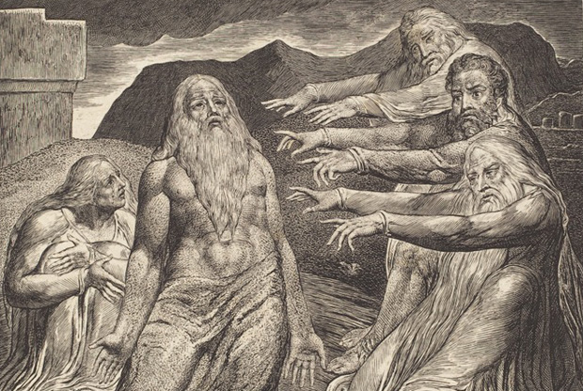
Extra
Sin, Death, and Suffering
Buddha’s Four Noble Truths
“My Father, if it is not possible that this cup pass without my drinking it, your will be done!”
-Jesus
Intrusive Thoughts
“The man who tries to conquer spirits by talk is like someone hoping to lock up the winds”-
“God knows what's in our hearts”
John Climacus
T.AF., Black and white thinking
Understanding rather than resistance
Truth is acceptance
The world is not perfect
More Fate and Fear
“Surely I spoke of things I did not understand, things too wonderful for me to know”
-Job
Why bad things happen to good people
Tolerating the unknown i.e. (uncertainty)

